Slide 1

Employee data set.
Presented by : m.Shalini
Reg.no:312214949
Department of commerce.
College: annai vellankanni’s college for women.

Slide 2
Agenda
Problem statement in project
Our solution of proposition
Dataset description
Modelling approach
Results
Conclusion

Slide 3
Problem statement
Employee data
Organanisation
Employee type
Collaboration

Slide 4
Our solution of proposition
Filtering
Pivot table—Summary of employee data
Pie chart
Formulas in the condition

Slide 5
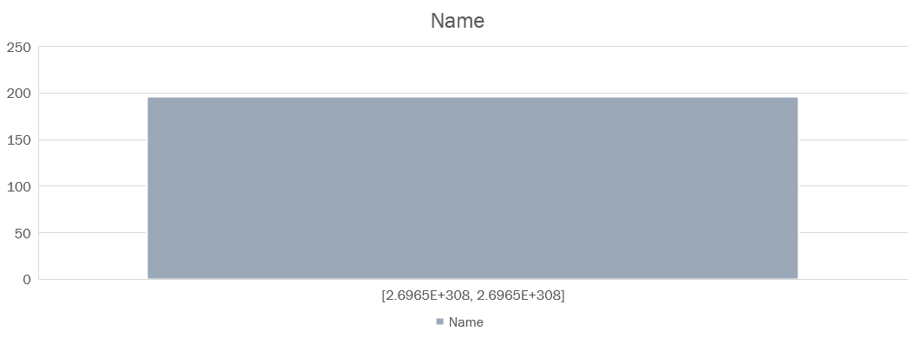
Dataset desription

Slide 6
Modelling approach
Dataset for the employee
Data cleaning for missed membrs listes and unvalued points removed
Poivt table—summary of business, gender ,employee type, salary
Chart for reports

Slide 7
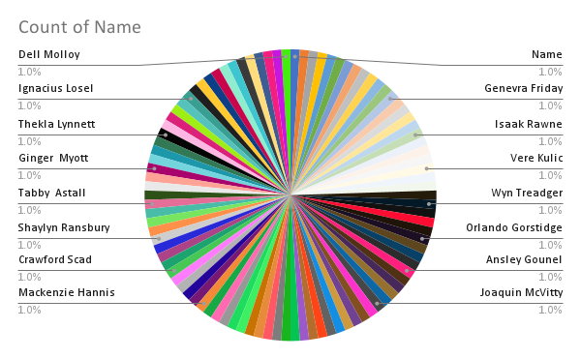
Results

Slide 8
Concluion
In the presention conclude .
This the one of boost in employees and business achivemdent

Slide 9
THANK YOU ….

